Slide 1
IMAGED BASED SCREENING PROGRAMS
Past, Present
and Future
New Hampshire Society of Radiologic Technologists
Spring Seminar
Catholic Medical Center, Manchester NH
April 5, 2014
Michael D. Luck, MD

Slide 2
Learning Objectives
Identify the purpose and rationale of screening and preventive medicine
Define the role of radiologic imaging in finding occult disease of the breast, colon, lung, circulatory system
Identify the parts of a successful screening program using LDCT for lung cancer
Define future directions for imaging in detecting disease in asymptomatic patients

Slide 3
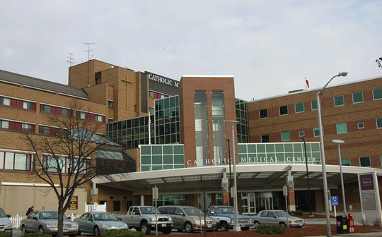
WELCOME!

Slide 4
And thank you!

Slide 5
Preventive medicine
Patient Protection and Affordable Care Act
Fundamentally shifts priorities of US health care with increased focus on preventive medicine
Encourages screening for asymptomatic individuals to identify deadly and costly diseases early when intervention may have effect
Legislated coverage of screening programs with zero cost sharing to programs endorsed by the USPSTF (US Preventive Services Task Force)

Slide 6
Preventive Medicine
Primary: prevent disease by reducing risk factors
smoking cessation, immunizations, PKU, diet /exercise counseling, smoke detectors, seatbelts
Secondary: detect disease or cancer early
Monitoring BP, weight measurements, blood tests, screening programs
Tertiary: manage an existing disease to minimize negative consequences, prevent complications
Allergen reduction in asthmatics, eye / foot checks in diabetics

Slide 7
Screening
A population based strategy to identify an a disease in people without signs or symptoms of the disease
Screening is unique in that it tests people apparently in good health
Types:
Universal
Case finding
Find those at increased risk

Slide 8
Screening: Principles
1. Should be important health problem (scope or degree)
acne vs melanoma
diabetes versus Batten’s disease
2. A treatment exists
3. Facilities are available
4. There is a latent stage of disease
5. A test is available
Wilson’s Criteria, WHO guidelines 1968

Slide 9
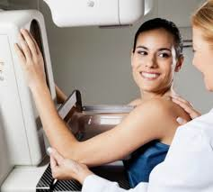
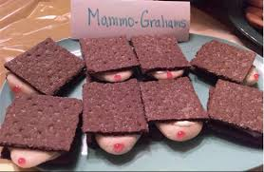
Screening: Principles(2)
6. Population accepts the test
7. Natural history of disease understood
8. Policy who to treat
9. Cost balanced
10. Continuous process

Slide 10
Common Screening Programs
Metabolic syndromes
Pregnancy: anemia, STDs, alpha-FP, Rh
PPD for Tb
Beck Depression Inventory
Domestic abuse
Bitewing radiographs for dental caries
Abdominal US for AAA
Cancer: skin exam, pap smear, mammo, colonoscopy, etc…

Slide 11
Screening Rationale
Asymptomatic
Early Disease
THERAPY
Disease Progression
Healthy
Reduced Illness
Death / Disabled

Slide 12
Screening: Limitations
No test is perfect!
Some may test positive without disease (False Positive)
Diseased people may test negative (False Negative)

Slide 13
Screening: Limitations (2)
Programs involve cost, resources, time for majority of people screened who do not have the disease
Adverse effects (radiation, discomfort, morbidity and mortality, etc..)
False sense of security with false negatives
Stress/anxiety if therapy does not improve life

Slide 14
M.P.H - Basics
Incidence = # of new cases of disease in the population during a time interval (i.e. - rate of getting the disease)
Primary prevention targets this
Prevalence = total # of cases of a disease in a population at a moment in time (i.e. - the proportion of disease + people)
Secondary prevention targets this

Slide 15
M.P.H – Basics (2)
Ideal screening test should be both sensitive (Sn) and specific (Sp)
Sensitivity = percentage of patients with a disease that test positive for the disease
Specificity = number of people who do not have the disease who test negative
Ideally, both would be 100% - but that doesn’t happen

Slide 16
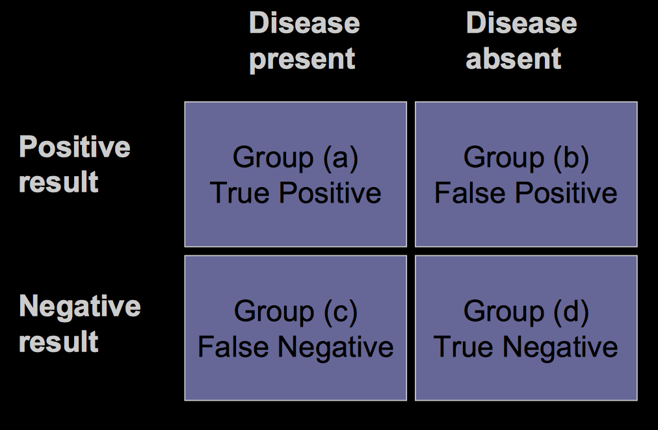
Classic 2 x 2

Slide 17
Sensitivity

Slide 18
Specificity

Slide 19
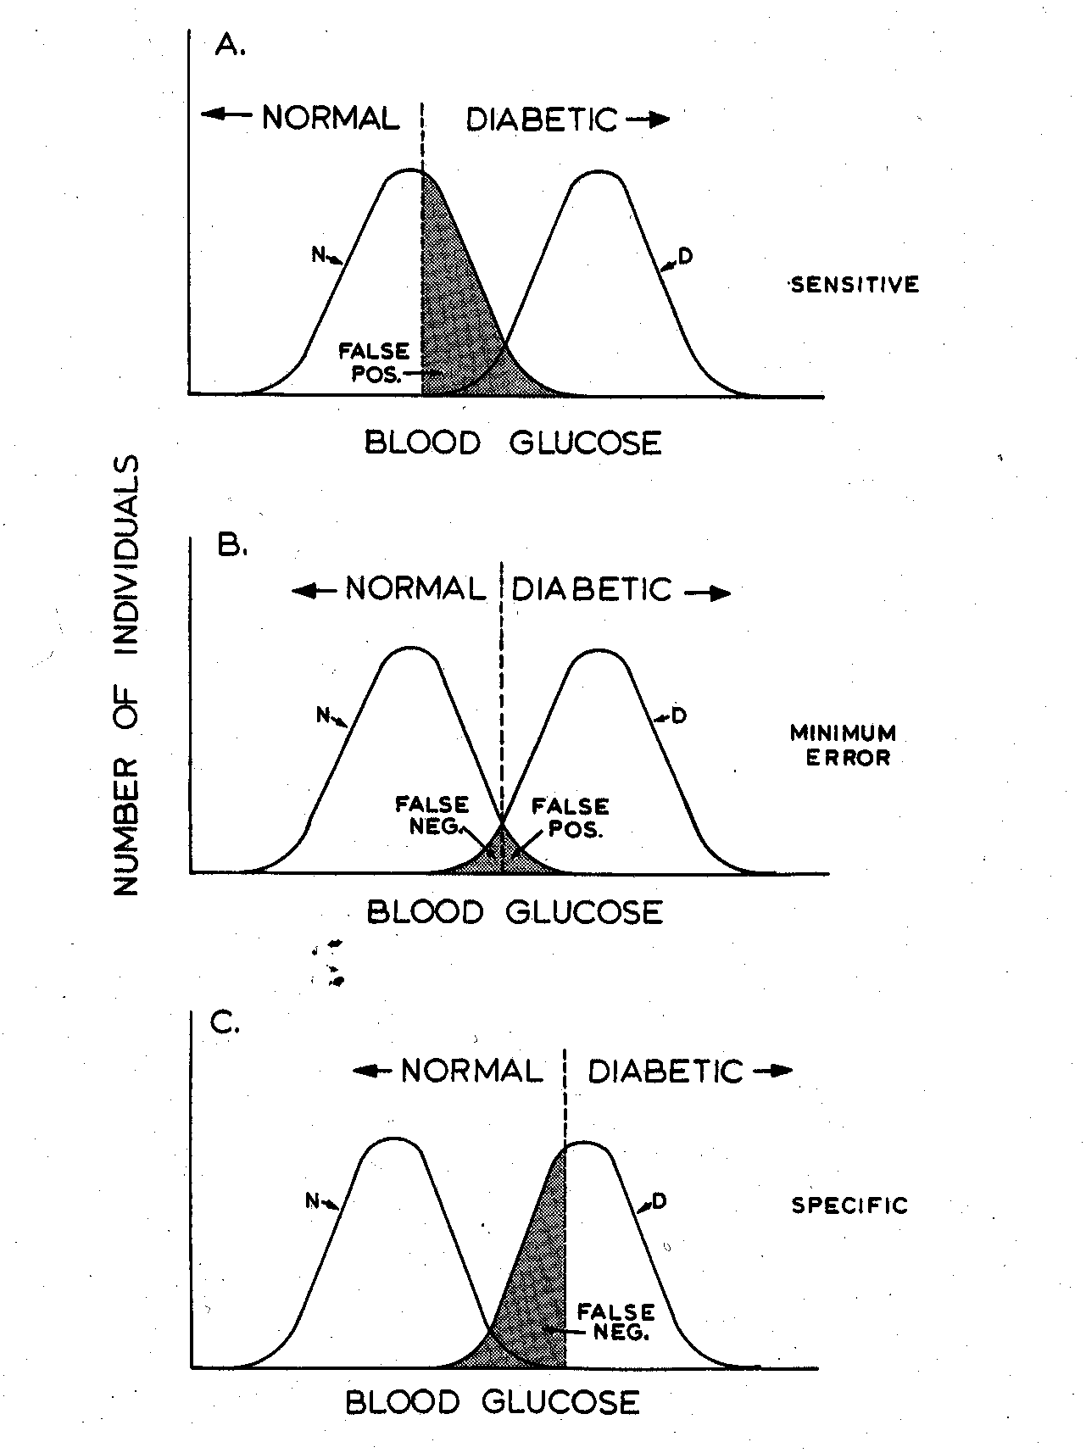
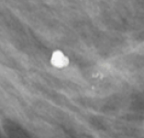
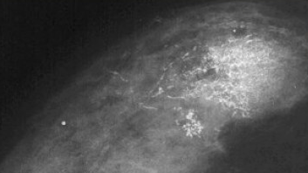
Trade Off: Sn vs Sp

Slide 20
Consequences of Sn / Sp
False Positive
Even if small %, it’s a large # applied to population
Costs for follow-up test, anxiety, morbidity,…
False Negative
Even if small, tragic lost opportunity for health improvement
May provide false sense security
May neglect future screening / lifestyle modifications

Slide 21
What does my test mean?
Sensitivity and Specificity are parameters of the test. That is - how good is that screening tool at finding what it is it’s looking for.
What people want to know is…
Do I have the disease or not?
That is addressed by other parameters

Slide 22
Positive Predictive Value

Slide 23
Negative Predictive Value

Slide 24
Predictive Values
Unlike sensitivity and specificity, PPV and NPV vary not with the test, but the population
Predictive values change with disease prevalence

Slide 25
Bayes Theorem
As the prevalence of a disease increases, the positive predictive value increases.
As the prevalence of a disease decreases, the negative predictive value decreases

Slide 26
2 Populations of 10,0000

Slide 27
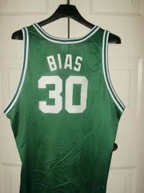
Screening Problems
Any systematic error that affects the evaluation of a screening test

Slide 28
Lead time Bias
Perceived increased length of survival due to catching awareness of disease early without changing course of disease

Slide 29
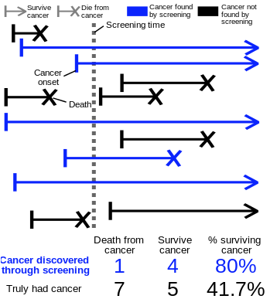
Length time bias
Slower growing cancers have better prognosis and are easier detected by interval screening. E.g catch cancers that would not have killed the patient anyway

Slide 30
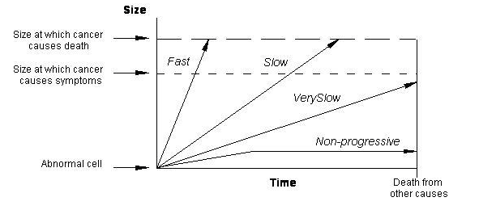
Overdiagnosis
Test finds disease that otherwise would not be detected nor cause death.

Slide 31
So with that….

Slide 32
Breast Cancer - Scope
Most common non-skin cancer in women
True or False: Most common cause of death in women.
FALSE – Heart disease!
True or False: Most common cause of cancer death in women
FALSE – Lung cancer!

Slide 33
Breast Cancer - Statistics
1.64 million cases worldwide in 2010
In US 2014 - 232,670 women will be diagnosed with breast cancer
40,000 US women will die this year from it
According to the American Cancer Society 130,000 US lives have been saved through early detection and treatment of breast cancer.

Slide 34
Mammograms – Early Successes
2012 meta-analysis of 11 randomized trials found a 20% relative risk reduction in breast cancer mortality (*predates improved therapies)
Systematic review of 8 other studies concluded that there is a risk reduction from breast cancer death in women (between 0.68-0.85 RR) (* not for women <40)
Sweden trials showed minimal all cause mortality reduction (very modest <2%)
Increased incidence detection of breast cancers in 1990s was mostly in early stage and DCIS

Slide 35
Problems
Multiple studies estimate that as many as 1 in 3 breast cancers may be overdiagnosed by mammography
As many as 1 in 5 mammographically detected cancers in asymptomatic women might spontaneously regress without medical intervention
Even though cancer detection increased, the # of late stage cancers is essentially unchanged. No change in mortality rate in these advanced cases

Slide 36
IMPROVEMENT: Finding it – or treating it?
There is extensive debate HOW much the reduction of breast cancer mortality seen (15-30%) is due to screening versus improved therapy
Some studies estimate only 2-10% may be attributed to screening mammography

Slide 37
Mammo - Harms
False +: ~ 11% screens in US require additional evaluation (call-backs)
Over 10 year period, 61% of women will be called-back and 7-9% will receive false-+ biopsy
2/3 of biopsies will be negative
Over 500,000 “unnecessary” biopsies performed each year
Cost: Over $1,000,000,000

Slide 38
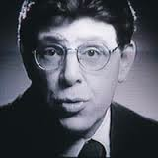
Harms – False Positives
US false positive rate is higher than that for UK – but cancer detection rates are similar between them
Why?
Ask Jim
Or any radiologist

Slide 39
What to do with women 40-50?
False positives are HIGH in younger women
Breasts are denser making detection less sensitive (but improved with digital)
Increases call backs (FP)
Increases false negatives
PPV of mammogram is LOWER because the prevalence of cancer is lower in this age group than women in 60s

Slide 40
Age groups
For 40-50: 1900 women need to be invited to screening in order to prevent just 1 death from breast cancer at cost of >20,000 imaging visits and 2000 false + biopsies
For 60-69: <400 women need to be invited to screening in order to prevent just 1 death from breast cancer at a cost of ! 5000 imaging visits and 400 false + biopsies

Slide 41
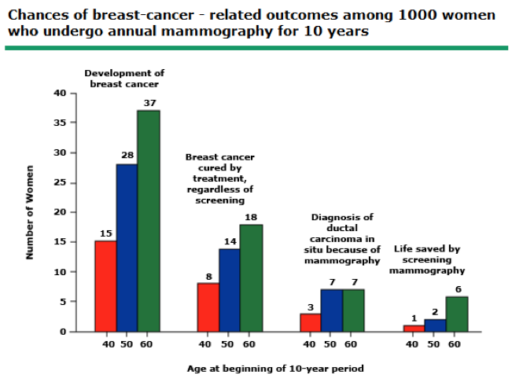

Slide 42
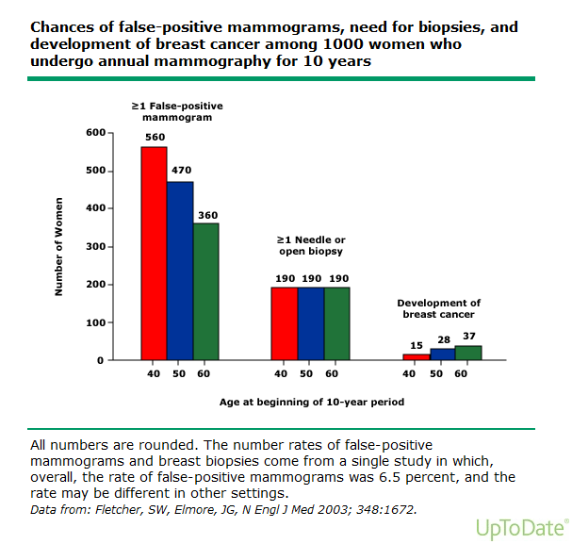
template

Slide 43
Where does that leave us?
Growing data suggest that:
Mammography’s initial benefit may have been overestimated
Mammography is good / beneficial – just not as good as initially thought (or hoped)
Mammography is necessary for many women, maybe just not for all or all age groups
Mammography should be performed at some frequency, but perhaps not every year

Slide 44
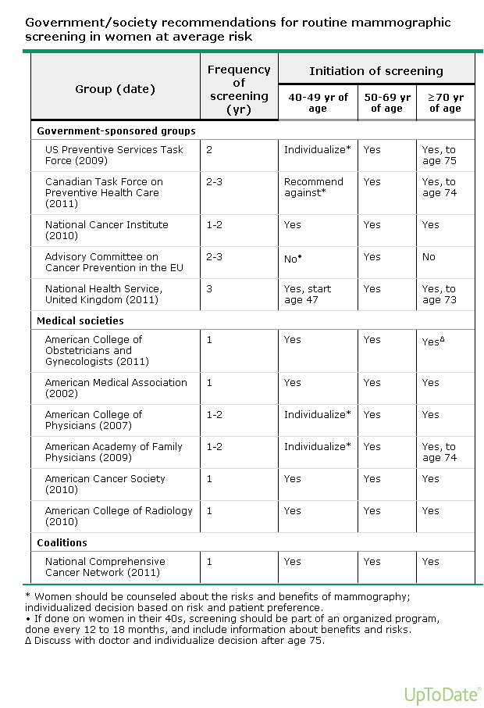
Current
Guidelines:
Who do you want to believe?

Slide 45
Cost Efficacy
Depends upon what group selected
$21,400 per year of life saved in women ages 50-69
$105,000 per year of life saved in women ages 40-49

Slide 46
Future improvements
Age selection (?)
Target disease group to optimize effect
Individualize for women in 40s
Frequency of screening (1 year or 2)
Little difference in stage of cancer seen in postmenopausal women if screened every 2 years
Premenopasual women (?) Do every year because if present, more biologically active

Slide 47
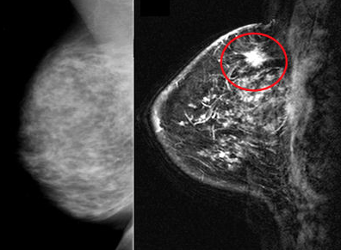
Technological: Breast MRI
Sn > mammo (0.77 versus 0.4)
Specificity < mammo (0.86 v 0.95)
Not rec. for lifetime risk less than 15%
High costs
Access to MR

Slide 48
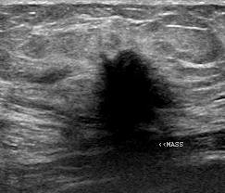
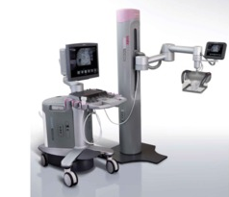
Technological: US
Not recommended for general population in screening
Adjunct modality to mammography
ABVS ? future role

Slide 49
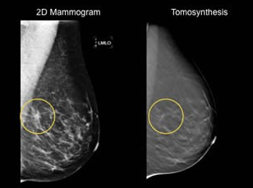
Technological: Tomosynthesis
Equal to better accuracy compared to digital mammography
Decreased false positives!
Oslo Screening Trial and Italian Screening with Tomosynthesis or Standard mammography Trial confirm significant recall rate reductions (15-17%) with impoved cancer detection rates (33-53%)

Slide 50
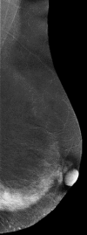
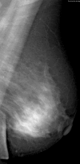
Technological: Contrast enhanced spectral mammography
CESM is better than CM in detecting cancer and comparable in Sn to MRI
Sn 92%, Sp 83%
Evolving role as adjunct

Slide 51
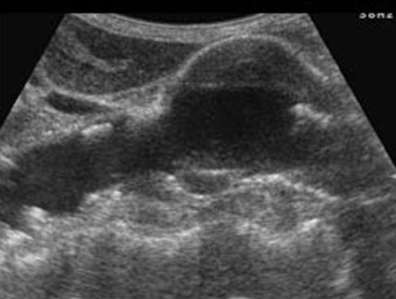
Abdominal Aortic Aneurysm: Finding a silent killer
Undetected AAA may → catastrophic rupture and death ( in @ 3% patients)
Ultrasound = modality of choice

Slide 52
AAA: US
High Sn (95-100%) and Sp (near 100%) for AAA by US; FP cleared by CT
Multicenter Aneurysm Screening Study (MASS)
42% reduction in mortality from aneurysm-related death
Overall reduction in all cause mortality by 3%
Twice as many elective AAA surgeries and half as many emergency salvage operations
216 patients invited to screening to save 1 life
Cost effective: $19,500 per-life year gained

Slide 53
USPTF Guidelines
Men 65-75 who have ever smoked
One time screening
Men >75 do not appear to benefit
Draft recommendation in 2014: clinicians may selectively offer AAA in men 65-75 who have never smoked based on medical history, family hx, personal values…
USPTF does NOT recommend for women
Soc Vasc Surgery does ( due to women having inc risk of rupture & +life expectancy benefit)

Slide 54
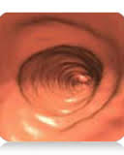
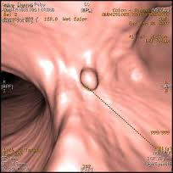
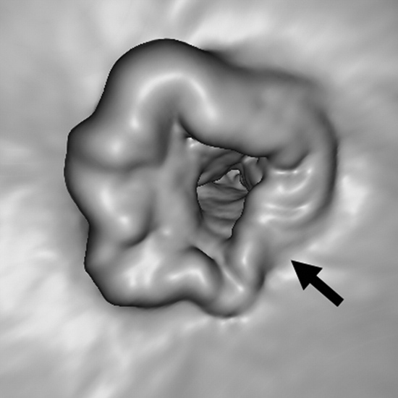
Colon Cancer
2nd leading CA death
9% of cancer deaths
3% of all deaths
Many test options:
FOBT
Flex sigmoidoscopy
DC-BE
Optical colonoscopy

Slide 55
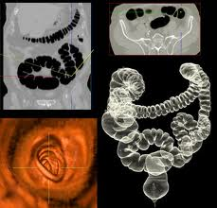
CT-Colonoscopy: Technique
Standard BE prep (Fleet)
Air insufflation (Co2 better tolerated)
3D volumetric scan
1 breath hold
Supine or supine/prone
Postprocessing 3D
+/- Stool tagging

Slide 56
CT-C: Performance
With optical tagging: Sn 94 %, Sp 96% for polyps > 10 mm, Optical colonoscopy Sn 88% in comparison
CT-C may find polyps on back side of mucosal folds better than OC
Decreased sensitivity with decreased polyp size
Polyps < 6mm ~48%
Polyps > 9 mm ~85%

Slide 57
Safety / Satisfaction
Patients tolerate CT-C more than DC-BE, but do prefer OC more (where they get drugs to make them forget!)
If given option, patients opt for CT-C > OC
2 published cases of colonic perforation to VC. No reported deaths
Radiation exposure – what about long-term effects? (effective 50mAs, 120 kVp)
Estimated 150 radiation induced cancers / 100,000 screened BUT prevent 3580-5190 / 100,000 colon cancers

Slide 58
CT Colonoscopy: If you build it, they might not come…
VC endorsed as screening by:
US multi society task force colon CA
American Cancer Society
American College of Radiology
Advantages:
minimally invasive
no sedation
improved safety,
relative low cost (only 15% more than OC)
But… 5 years later
Challenges to acceptance by MDs, reimbursement
More costly overall strategy

Slide 59
CT-C: Recommendations
Screening option for colon cancer detection in asymptomatic patients 50 or older at average risk
Test repeated every 5 years
F/u OC for polyps > 6mm
NOT recommended in patients with history of polyps or those of increased risk

Slide 60
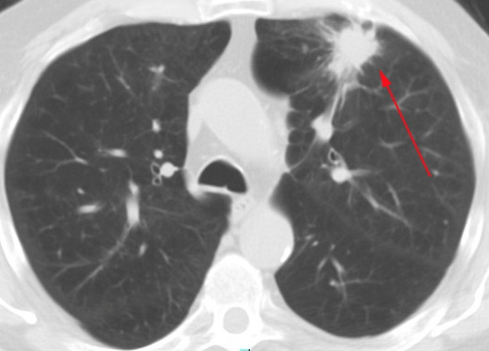
Lung Cancer
2nd most common in US
228,190 new cases in 2013
159,480 deaths (27% of all CA related)
Up to 75% of patients present with symptoms due to advanced local or metastatic disease
5 year survival ~ 16% for all
BUT survival is highly dependent on stage

Slide 61
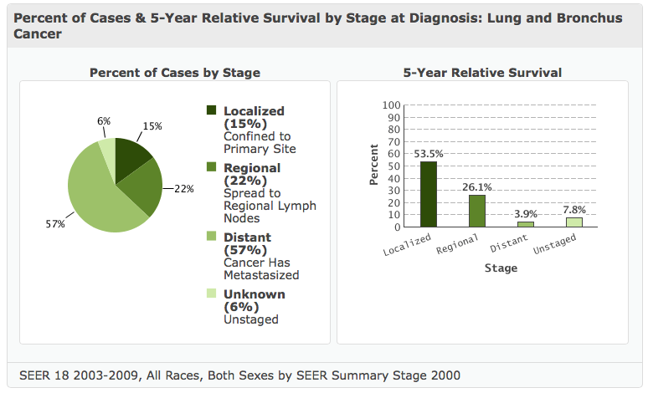
5 year survival by stage
template

Slide 62
CXR: We’ve tried this before
There have been at least 7 well designed randomized trials with chest x-ray. None have demonstrated a mortality benefit for chest radiographs
Why?
Poor Sensitivity of radiographs
Some trials had an increased cancer detection rate but NOT in early stage

Slide 63
National Lung Screening Trial
Randomized trial by NCI – compared annual low dose CT vs CXR for 3 years
* >53,00 HIGH RISK men and women 55-74 with 30+ pack-year smoking history
Interim analysis found 20% improved lung-cancer specific mortality benefit with absolute reduction 62 deaths /100,000 person years
Overall 6.7% overall mortality benefit

Slide 64
NLST: It’s working. STOP IT!
Trial stopped early for ethical reasons
~8.6 million in US would qualify using criterion → 12,000 lives saved PER YEAR
LDCT may lead to decreased mortality from lung cancer by 18-25%
Cost $126,000-269,000 quality adjusted life year
False + high: 96.4 % LDCT v 94.5 CXR

Slide 65
NLST: Success
Why did it work?
Select patient population of HIGH risk
High sensitivity of CT (94%), Sp (73%)
Fewer stage IV cancers found with LDCT
Most cancers Stage 1 or 2 (70% vs 57%)
Low complication rate of interventions

Slide 66
Building a lung cancer program

Slide 67
Building a program
Build comprehensive lung cancer screening program infrastructure from the ground up.
Lung cancer screening program coordinator
Patient navigator position
Radiology working group : radiologists, technologists, administrative director, scheduling team leaders, and PACS adminstrator

Slide 68
Program elements
Toll-free number
Central acceptance and routing of program-directed patient inquiries
Intake forms
Call center script
FAQ document
Patient
Program literature
Low-dose lung cancer screening scanning protocols

Slide 69
Standardize reporting: LUNG-RADS
LungRADS 1: Negative - next LDCT in 12 months
Solid nodules < 4 mm
Ground glass nodules < 5 mm
Characteristically benign findings: atelectasis, scarring, calcified granuloma, etc
LungRADS 2: Benign - next LDCT in 12 months
Solid nodules > 4 mm but stable for > 2 years
Biopsy proven benign histology (eg, necrotizing granuloma)
LungRADS 3: Positive, likely benign (< 4% chance of malignancy)
Solid nodules 4-8 mm or ground glass nodules > 5 mm next LDCT in 3-6 months
Stable nodules without documented 2 years of stability next LDCT in 6-12 months
Probable infection/inflammation → next LDCT in 1·2 months, consider antibiotics

Slide 70
LungRADS (2)
LungRADS 4: Positive, suspicious for malignancy (> 4% chance of malignancy)
Growing solid or ground glass nodule
Solid nodule greater than 8 mm
Other findings suspicious for malignancy (adenopathy/effusion)
Pulmonary consultation advised
LungRADS 5: Known cancer
Significant incidental findings "Category S":
Positive(P) or Negative(N)
Indeterminate breast, liver, kidney, adrenal lesions, aneurysms, etc
10 final assessments (1P, 1N, 2P, 2N, 3P, 3N, 4P, 4N, 5P, 5N)

Slide 71
template
Result Group 1 Group 2 Lahey NLST
Positive: Overall
nodule 23.8% 28.1% 25% 27%*
Positive:
infection 5.4% 6.1% 5.6% NR
S positive 5.4% 6.1% 5.6% 10.2%*
Note: *; NLST National Lung Screening Trial; NR not reported.

Slide 72
Patient Access
Who is going to pay?
Most public and private payers, including CMS, currently do not reimburse for CT lung screening, with a few notable exceptions
Self-pay rates for CT lung screening (ranging from $99 to $1,000) create access disparities among high-risk individuals of varying financial means
Low-volume screening is potentially ineffective, as 320 individuals need to be screened to save 1 life according to the NLST
Free?

Slide 73
Business Considerations
Availability of downtime on installed CT
Use scan when outpatient activity at the institution decreases
Relatively quick exam. No IV or contrast needed. Simple protocol.

Slide 74
Financial Considerations
By modeling the Lahey experience, 60% to 80% of the revenue available to offset the cost of free screening would be derived from treating lung cancer
In years 3 to 10, the revenue derived from interval diagnostic LDCT follow-up of small pulmonary nodules and lung cancer treatment become equally important revenue sources.
20-30% of scans generate more imaging

Slide 75
Table 3. Positive results Lahey vs National Lung Screening Trial (NLST)
Result Group 1 Group 2 Lahey NLST
Positive: Overall
nodule 23.8% 28.1% 25% 27%*
Positive:
infection 5.4% 6.1% 5.6% NR
S positive 5.4% 6.1% 5.6% 10.2%*
Note: *; NLST National Lung Screening Trial; NR not reported.

Slide 76
Patient Questionaire Who should get an LDCT lung screening exam?
LDCT lung screening is recommended for the following groups of people who are at high risk for lung cancer.
Those who have symptoms of a lung condition at the time of screening, such as a new cough or shortness of breath, are not eligible.
• Group 1: People ages 55−74 who have smoked at least an average of 1 pack a day for 30 years. This includes people who still smoke or have quit within the past 15 years.
• Group 2: People ages 50−74 who currently or in the past have smoked at least an average of 1 pack a day for 20 years. They must also have at least 1 other risk factor for lung cancer, not including exposure to secondhand smoke.

Slide 77
How is the exam performed?
LDCT lung screening is one of the easiest screening exams you can have. The exam takes less than 10 seconds.
No medications are given, and no needles are used.
You can eat before and after the exam.
You do not even need to get changed as long as the clothing on your chest does not contain metal.
You must, however, be able to hold your breath for at least 6 seconds while the chest scan is being taken.

Slide 78
Radiation exposure:
LDCT lung screening uses radiation to create images of your lung.
Radiation can increase a person’s risk of cancer.
By using special techniques, the amount of radiation in LDCT lung screening is small—about the same amount a person would receive from a screening mammogram.
Further, your doctor has determined that the benefits of the screening outweigh the risks of being exposed to the small amount of radiation from this exam.

Slide 79
False positives/additional testing:
LDCT lung screening very often finds something in the lung that could be cancer but in fact is not. This is called a false positive.
False positive tests often cause anxiety.
In order to make sure these findings are not cancer, you may need to have more tests. These tests will be performed only if you give us permission.
Occasionally, patients need a procedure, such as a biopsy, that can have potential side effects.
For more information on false positives, see “What can I expect from the results?”

Slide 80
Findings not related to lung cancer:
Your LDCT lung screening exam also captures images of areas of your body next to your lungs.
In a small percentage of cases (5%−10%), the CT scan will show an abnormal finding in one of these areas, such as your kidneys, adrenal glands, liver or thyroid.
This finding may not be serious; however, you may need to be examined further.
Your healthcare provider who ordered your exam can help determine what, if any, additional testing you may need.

Slide 81
What can I expect from the results?
About 1 out of 4 LDCT lung screening exams will find something that may require additional imaging or evaluation. Most of the time these findings are lung nodules.
Lung nodules are very small collections of tissue in the lung. These are very common, and the vast majority— more than 97%—are not cancer (benign). Most are normal lymph nodes or small areas of scarring from past infections.
Less commonly, lung nodules are cancer. If a small lung nodule is found to be cancer, the cancer can be cured more than 90% of the time. That is why we are screening you.

Slide 82
What can we expect in radiology?
Increase in the use of preventive medicine
Increased utilization of screening programs
More selective patient populations in screening programs to maximize those who most benefit and decrease costs
Emerging technologies that we will have to learn how to employ efficiently and effectively

Slide 83
And…. Working with great technologists!

